Slide 1
Object Oriented Programming
C++ Operator Overloading
Abeeda Akram

Slide 2
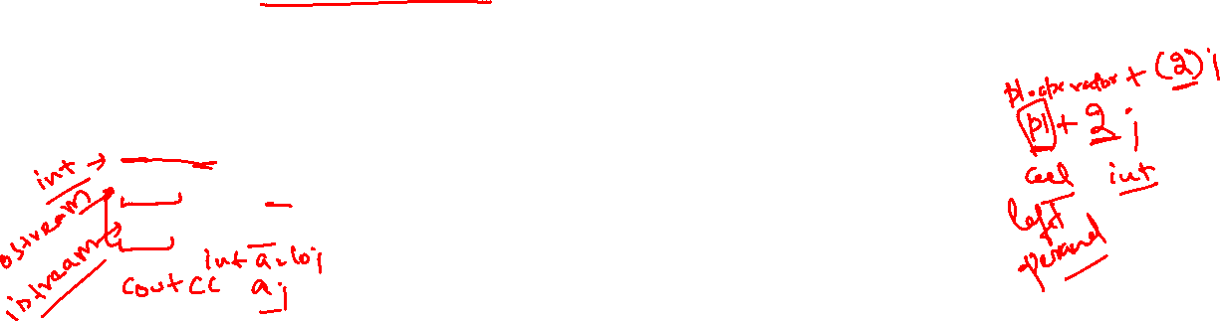
When Non-member functions needed?
Member functions cannot be defined, if left operand of operation is not class object for example.
  2 + p1; // left operand is int
  cout << p1; // left operand is ostream class object
  cin >> p1; //left operand if istream class object
Therefore, Non-member functions can be used for such operations.

Slide 3
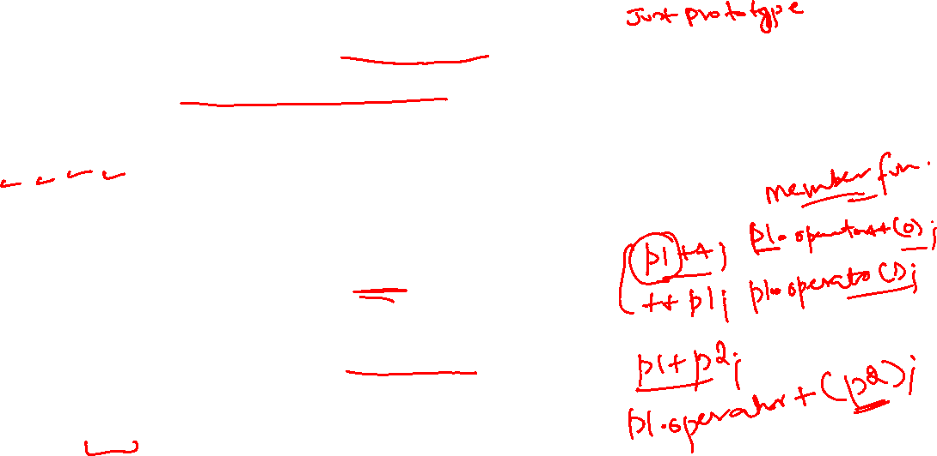
Non-Member Functions
Non-member function cannot be defined inside the class
They cannot access the private data members of a class
Operators that cannot be overloaded through non-member functions are
  =, [], (), ->, &(address of operator)
All other operators can be overloaded through non-member functions
Unary operators
  Non-member function, needs one argument
Binary operators
  Non-member function, needs two arguments
  One argument must be class object or reference
There is no this pointer in non-member functions

Slide 4
Non-Member Friend Functions
friend function can access private and protected members of another class
  friend functions are non-member functions of class
  They are defined outside of class scope
  Can only add prototype inside class definition for granting friendship
  There is no this pointer in non-member friend functions
Properties of friendship
  Friendship is granted, not taken
  Not symmetric (if B a friend of A, A not necessarily a friend of B)
  Not transitive (if A is friend of B, B is friend of C, A not necessarily a friend of C)

Slide 5
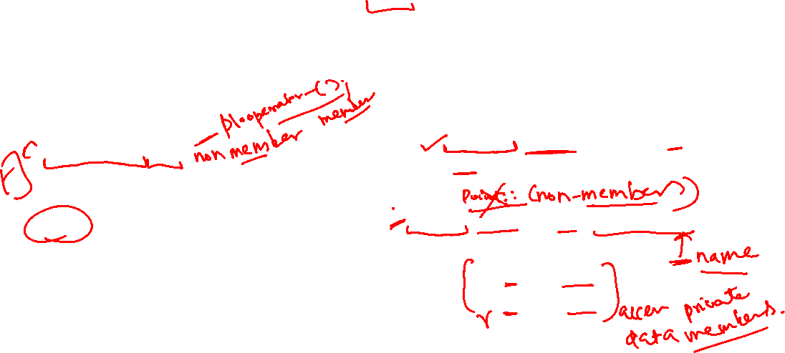
Unary Operator Minus (-)
Non-member function takes one argument that must be the class object.
Can be called in two ways.
  Point p1(3, 4);
  operator-(p1);
  // calls friend function
  Or
  -p1;
  Point p2 = -p1;
Only add one function member or non-member friend to avoid conflict.
class Point {
  int x, y;
public:
  Point(int a=0, int b=0) { x=a; y=b;}
  friend Point operator–(const Point&); // prototype
};
Point operator-(const Point& p) {
    Point r(p);
    r.x = -p.x;
    r.y = -p.y;
    Return r;
}

Slide 6
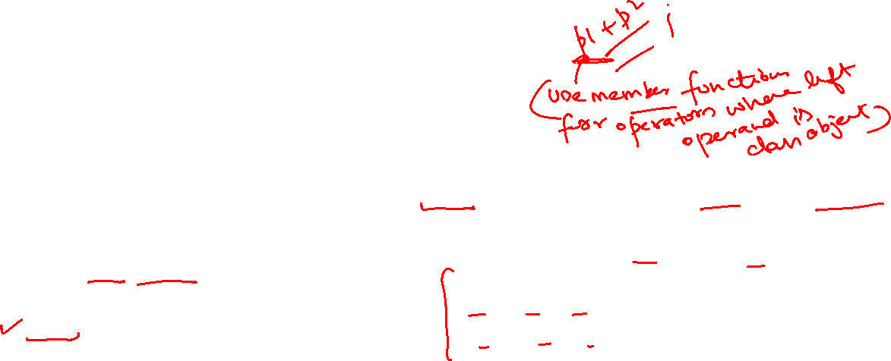
Binary Operator Addition (+)
class Point {
  int x, y;
public:
  Point(int a=0, int b=0) { x=a; y=b;}
  friend Point operator+ (const Point& , const Point&);
};
Point operator+(const Point& p, const Point& q){
Point R;
R.x = p.x + q.x;
R.y = p.y + q.y;
return R;
}
Both operands are class objects.
Non-Member function takes two arguments.
Can be called in two ways.
  Point p1(3, 4), p2(3, 2);
  operator+(p1,p2);
  Or
  p1+p2;
  // both p1 and p2 are passed as arguments
  Point p3 = p1+p2;
  // cascaded call

Slide 7
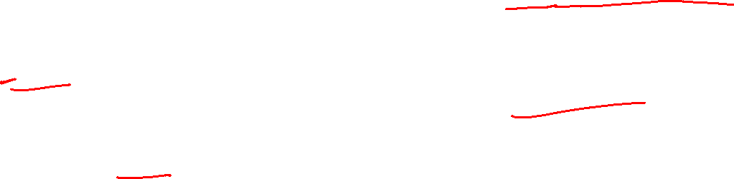
Binary Operator Addition (+)
One operand left one is class object.
Non-member function takes two arguments
Can be called in two ways.
  Point p1(3, 4);
  operator+(p1,3);
  Or
  p1+10;
  // both p1 and int 10 are passed as arguments
  int a = 10;
  Point p3 = p1+a;
  // cascaded call
class Point {
  int x, y;
public:
  Point(int a=0, int b=0) { x=a; y=b; }
friend Point operator+ (const Point& p, const Point& q);
friend Point operator+ (const Point& p, const int & n); // with int
};
Point operator+(const Point& p, const int& n){
Point R;
R.x = p.x + n;
R.y = p.y + n;
return R;
}

Slide 8
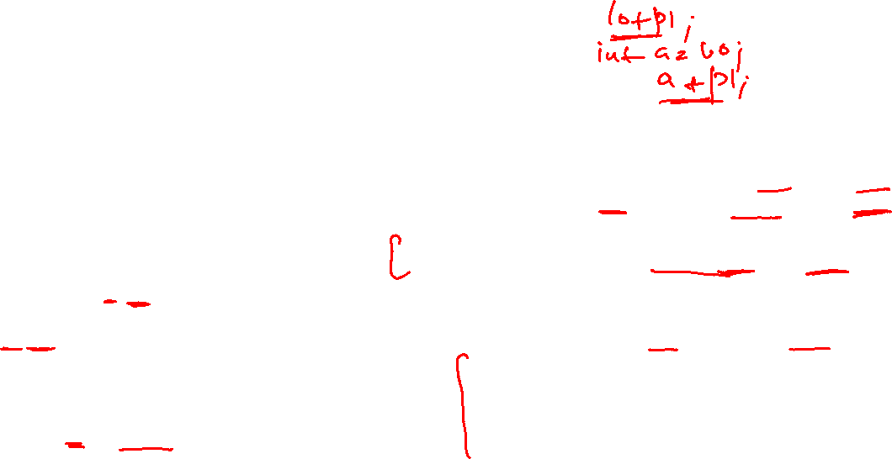
Binary Operator Addition (+)
One operand right one is class object
Must define non-member function.
Non-member function takes two arguments
Can be called in two ways.
  Point p1(3, 4);
  operator+(3,p1);
  Or
  10+p1;
  // both p1 and int 10 are passed as arguments
  int a = 10;
  Point p3 = a+p1;
  // cascaded call
class Point {
  int x, y;
public:
  Point(int a=0, int b=0) { x=a; y=b; }
friend Point operator+ (const Point& p, const Point& q);
friend Point operator+ (const Point& p, const int & n);
// with int right operand
friend Point operator+ (const int& n, const Point& p);
// with int left operand
};
Point operator+(const int& n, const Point& p){
Point R;
R.x = p.x + n;
R.y = p.y + n;
return R;
}

Slide 9
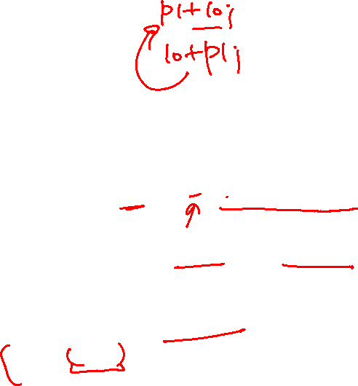
Binary Operator Addition (+)
One operand right one is class object
Must define non-member function.
Non-member function takes two arguments
Can be called in two ways.
  Point p1(3, 4);
  operator+(3,p1);
  Or
  10+p1;
  // both p1 and int 10 are passed as arguments
  int a = 10;
  Point p3 = a+p1;
  // cascaded call
class Point {
  int x, y;
public:
  Point(int a=0, int b=0) { x=a; y=b; }
friend Point operator+ (const Point& p, const Point& q);
friend Point operator+ (const Point& p, const int & n);
// with int right operand
friend Point operator+ (const int& n, const Point& p);
// with int left operand
};
Point operator+(const int& n, const Point& p){
return p + n;
// Reuse code of right operand function
}

Slide 10
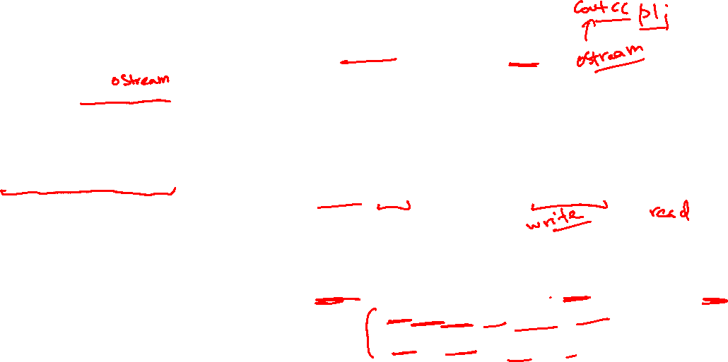
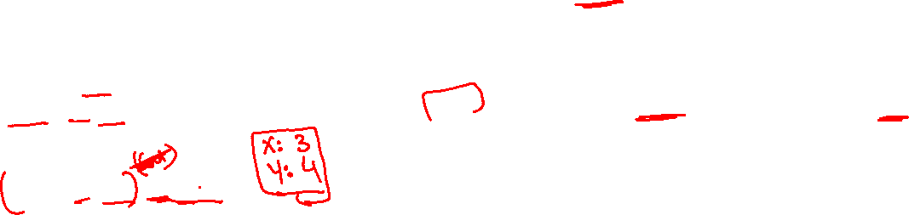
Binary Operator Stream insertion (<<)
One operand left one is stream object and right one is class object
Must define non-member function, which takes two arguments
  First non constant reference of ostream object
  Second const reference of class object
Called as follows.
  Point p1(3, 4), p2(1, 2);
  cout << p1; // left operand is ostream class object
  cout << p1 << p2;
  // cascading will not work as return type is void
class Point {
  int x, y;
public:
  Point(int a=0, int b=0) { x=a; y=b; }
friend void operator<< (ostream& , const Point&);
};
// insert or write data of object member wise in stream
void operator << (ostream & out, const Point& p){
out << "X:" << p.x << endl;
out << "Y:" << p.y << endl;
}

Slide 11
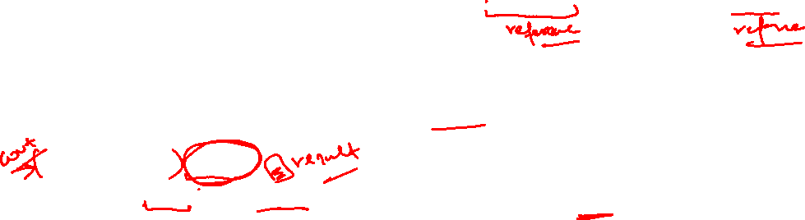
Binary Operator Stream insertion (<<)
One operand left one is stream object and right one is class object
Must define non-member function, which takes two arguments
  First non constant reference of ostream object
  Second const reference of class object
For cascading return ostream object by reference from function.
  Point p1(3, 4), p2(1, 2);
  cout << p1 << p2;
  cout << ++p1 << p2+3;
  // cascading will work now
class Point {
  int x, y;
public:
  Point(int a=0, int b=0) { x=a; y=b; }
friend ostream& operator<< (ostream& , const Point&);
};
// insert or write data of object member wise in stream
ostream& operator << (ostream & out, const Point& p){
out << "X:" << p.x << endl;
out << "Y:" << p.y << endl;
    return out;
}

Slide 12

Binary Operator Stream extraction (>>)
class Point {
  int x, y;
public:
  Point(int a=0, int b=0) { x=a; y=b; }
friend void operator>> (istream & ,Point&);
};
// input data from stream and write member wise in object
void operator >> (istream & in, Point& p){
in >> p.x;
in >> p.y;
}
One operand left one is stream object and right one is class object
Must define non-member function, which takes two arguments
  First non constant reference of istream object
  Second non constant reference of class object
Called as follows.
  Point p1, p2;
  cin >> p1; // left operand is istream class object
  cin >> p1 >> p2;
  // cascading will not work as return type is void

Slide 13
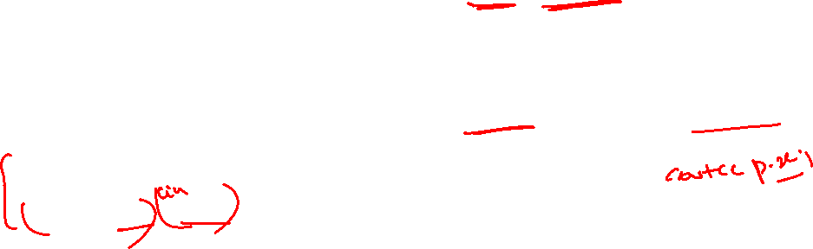
Binary Operator Stream extraction (>>)
class Point {
  int x, y;
public:
  Point(int a=0, int b=0) { x=a; y=b; }
friend istream& operator>> (istream & , Point&);
};
// input data from stream and write member wise in object
istream& operator >> (istream & in, Point& p){
in >> p.x;
in >> p.y;
return in;
}
One operand left one is stream object and right one is class object
Must define non-member function, which takes two arguments
  First non constant reference of istream object
  Second non constant reference of class object
For cascading return istream object by reference from function.
  Point p1, p2;
  cin >> p1 >> p2;
  // cascading will work now

Slide 14
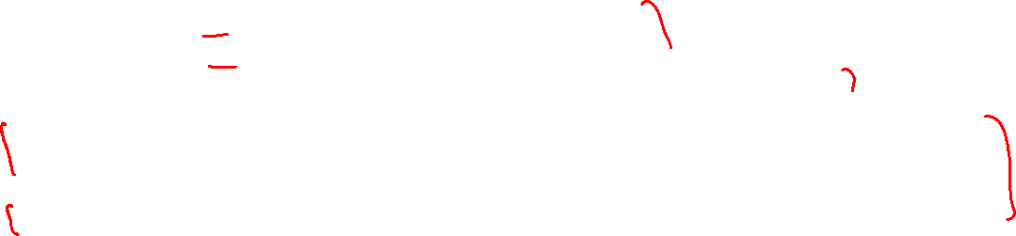
Complete the implementation of myarray
class myArray{
  int size; // Array size int *ptr; // Pointer for dynamic 1-D Array
public:
  myArray() { size=0; ptr=nullptr; }
  myArray(int size);
  myArray(int * arr, int size);
  myArray(const myArray&); // copy constructor
  ~myArray();
  myArray& operator=(const myArray &); // Assignment
  int& operator[](const int i);
  const int & operator[](const int i) const;
  myArray& operator++(); // increment data of all elements
  myArray operator++(int); // increment data of all elements
  bool operator==(const myArray &); //compare size and data of all elements
  bool operator!=(const myArray &);
  friend istream& operator>> (istream& , myArray&); //take size and data from console
  friend ostream& operator<< (ostream& , const myArray &); // Print data of array on console
  myArray operator+(const myArray &); // Return array containing data of both arrays merged
  friend myArray operator+(const int , const myArray &); // add int value to all elements of array
};

